Slide 1



DATA STRUCTURE AND ANALYSIS
TOPIC : Brute Force Password Cracking
BARATH SANKAR S - 24ITR019

Slide 2
PROBLEM STATEMENT
Password security is important to protect systems from unauthorized access.
Weak passwords can be cracked using Brute Force attacks.
In a brute force attack, every possible password combination is tried.
A cybersecurity firm wants to test the strength of passwords.
Design a program that cracks a password and measures the time taken.

Slide 3
OBJECTIVE
To understand the Brute Force algorithm technique
To simulate a password cracking process
To analyze the time complexity of brute force searching
To measure how long it takes to break passwords of different lengths
To demonstrate the importance of strong passwords in cybersecurity

Slide 4
ALGORITHM DESIGN TECHNIQUE
Input: target_password
Define character_set (letters and numbers)
start_time = current time
for each possible combination in character_set:
generate password_guess
if password_guess == target_password:
end_time = current time
print password_guess
print time taken
stop
continue generating next combination

Slide 5
APPROACH
First, take the target password as input.
Define a character set that includes letters and numbers used to generate passwords.
Start generating all possible combinations of characters from the character set.
Compare each generated password with the target password.
If the generated password matches the target password, stop the process and display the password along with the time taken.

Slide 6
CODING
public class Main {
public static void main(String[] args) {
String targetPassword = "ab1"; // password to crack
String characters = "abcdefghijklmnopqrstuvwxyz0123456789";
long startTime = System.currentTimeMillis();
for (int i = 0; i < characters.length(); i++) {
for (int j = 0; j < characters.length(); j++) {
for (int k = 0; k < characters.length(); k++) {
String guess = "" + characters.charAt(i)
+ characters.charAt(j)
+ characters.charAt(k);
if (guess.equals(targetPassword)) {
long endTime = System.currentTimeMillis();
System.out.println("Password Cracked: " + guess);
System.out.println("Time Taken: " + (endTime - startTime) + " ms");
return;
}
}
}
}
}
}

Slide 7
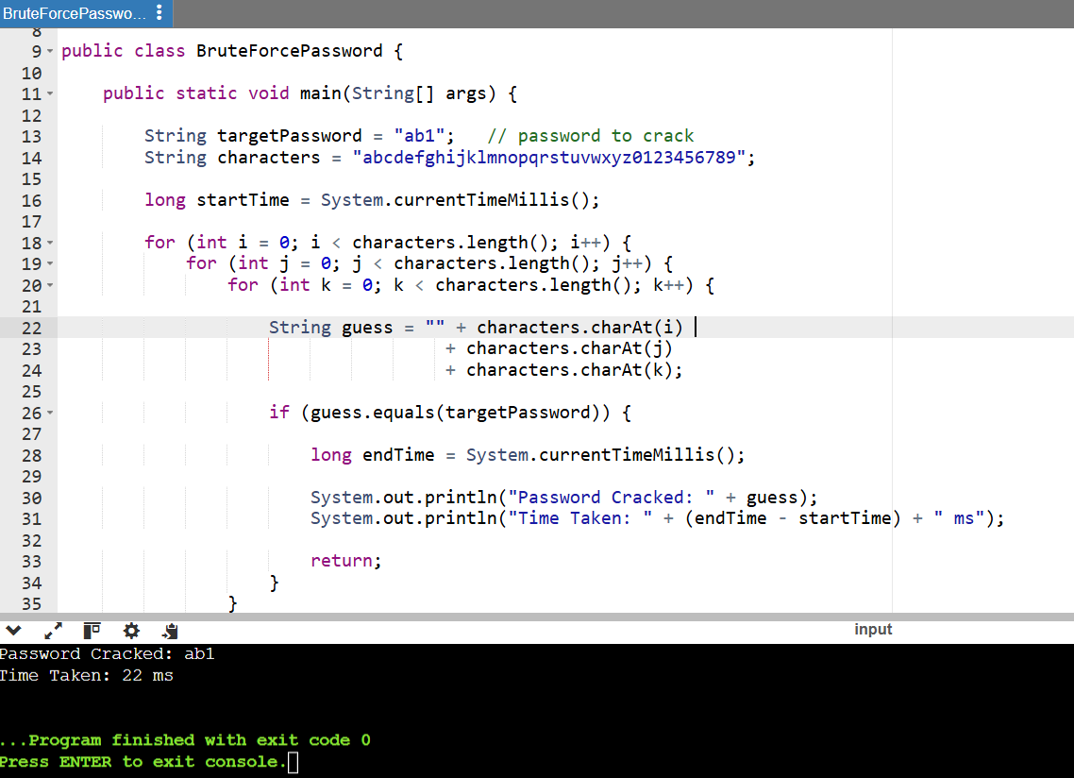
CODING OUTPUT

Slide 8
TIME COMPLEXITY DERIVATION
Let
n = length of the password,c = number of characters in the character set
Example:
If characters = 26 letters + 10 digits
c=36
Total possible password combinations:c^n
In each iteration:
• Generate a password combination
• Compare it with the target password
Each iteration takes constant time.
Worst Case:
The correct password is found at the last combination.
T(n)=c^n
Best Case:
The correct password is found immediately.
T(n)=1
Therefore:
T(n)=O(c^n)

Slide 9
CONCLUSION
The brute force method tries every possible password combination to find the correct one.
It is simple to implement but requires more time for longer passwords.
The time needed to crack a password increases as the password length increases.
Therefore, using longer and more complex passwords improves security.

Slide 10
THANK YOU

